Slide 1
SPAMMER DETECTION AND FAKE USER IDENTIFICATION IN SOCIAL NETWORKS
COURSE CODE: SWE3099
17MIS1002
P.PAVITHRA

Slide 2
Synopsis:
Introduction
Abstract
Objective
Motivation
Proposed Solution
System Architecture
Algorithms Used
Modules
Experimental Results
Conclusion
References
Certificate of Completion

Slide 3
Introduction:
It has become quite simple to obtain any kind of information from any source across the world by using the Internet. The increased demand of social sites permits users to collect abundant amount of information and data about users. Huge volumes of data available on these sites also draw the attention of fake users . Twitter has rapidly become an online source for acquiring real-time information about users. Twitter is an Online Social Network (OSN) where users can share anything and everything, such as news, opinions, and even their moods.
Recently, the detection of spam in social networking sites attracted the attention of researchers. Spam detection is a difficult task in maintaining the security of social networks. It is essential to recognize spams in the OSN sites to save users from various kinds of malicious attacks and to preserve their security and privacy.
These hazardous manipulative skills adopted by spammers cause massive destruction of the community in the real world. Twitter spammers have various objectives, such as spreading invalid information, fake news, rumors,etc.
Spammers achieve their malicious objectives through advertisements and several other means where they support different mailing lists and subsequently dispatch spam messages randomly to broadcast their interests. These activities cause disturbance to the original users who are known as non-spammers. In addition, it also decreases the reputation of the OSN platforms.
Therefore, it is essential to design a scheme to spot spammers so that corrective efforts can be taken to counter their malicious activities

Slide 4
Abstract:
Social networking sites engage millions of users around the world. The users interactions with these social sites, such as Twitter and Facebook have a huge impact and occasionally unpleasant things that happen in daily life.
The prominent social networking sites have turned into a target platform for the spammers to dump a huge amount of irrelevant and hurtful information. Twitter, for example, has become one of the most commonly used platforms of all times and therefore allows an unreasonable amount of spam.
Fake users send unwanted tweets to users to promote services or websites that not only affect legitimate users but also disrupt resource consumption. Moreover, the possibility of expanding invalid information to users through fake identities has increased that results in massive harmful content.
Recently, the detection of spammers and identification of fake users on Twitter has become a common area of research in contemporary online social Networks (OSNs). In this , we perform a review of techniques used for detecting spammers on Twitter.
Moreover, a taxonomy of the Twitter spam detection approaches is presented that classifies the techniques based on their ability to detect: (i) fake content, (ii) spam based on URL, (iii) spam in trending topics, and (iv) fake users. The presented techniques are also compared based on various features, such as user features, content features, graph features, structure features, and time features.

Slide 5
Objective:
The main objective of this project is to detect spammers and identify fake users in OSN sites(TWITTER) by using Machine learning Algorithms like Naïve bayes classifier to find spam or no-spam and Random forest algorithm to find fake user or not in order to protect users from malicious attacks and also to maintain privacy and security and also to maintain reputation of the social networking sites.

Slide 6
Motivation:
Social networks can provide a range of benefits to members of an organisation:
Support for learning: Social networks can enhance informal learning and support social connections within groups of learners and with those involved in the support of learning.
Support for members of an organisation: Social networks can potentially be used my all members of an organisation, and not just those involved in working with students. Social networks can help the development of communities of practice.
Engaging with others: Passive use of social networks can provide valuable business intelligence and feedback on institutional services (although this may give rise to ethical concerns).
Ease of access to information and applications: The ease of use of many social networking services can provide benefits to users by simplifying access to other tools and applications. The Facebook Platform provides an example of how a social networking service can be used as an environment for other tools

Slide 7
Proposed Solution:
Fake Content:
If the number of followers is low in comparison with the number of followings, the credibility of an account is low and the possibility that the account is spam is relatively high. Likewise, feature based on content includes tweets reputation, HTTP links, mentions and replies, and trending topics. For the time feature, if many tweets are sent by a user account in a certain time interval, then it is a spam account.
Spam URL Detection:
The user-based features are identified through various objects such as account age and number of user favourites, lists, and tweets. The identified user-based features are parsed from the JSON structure. On the other hand, the tweet-based features include the number of (i) retweets, (ii) hashtags, (iii) user mentions, and (iv) URLs. Using machine learning algorithm called Naïve Bayes we will check whether tweets contains spam URL or not.

Slide 8
Detecting Spam in Trending Topic:
In this technique tweets content will be classified using Naïve Bayes algorithm to check whether tweet contains spam or non-spam words. This algorithm will check for spam URL, adult content words and duplicate tweets. If Naïve Bayes detect tweet as SPAM then it will return 1 and if not detected any SPAM content then Naïve Bayes will return 0.
Fake User Identification:
These attributes include the number of followers and following, account age etc. Alternatively, content features are linked to the tweets that are posted by users as spam bots that post a huge amount of duplicate contents as contrast to non-spammers who do not post duplicate tweets. In this technique features (following, followers, tweet contents to detect spam or non-spam content using Naïve Bayes Algorithm) will be extracted from tweets and then classify those features with Naïve Bayes Algorithm as spam or non-spam. Later this feature will be train with random forest algorithm to determine account is fake or non-fake. All extracted features will be saved inside features.txt file. Naïve Bayes classifier saved inside ‘model’ folder.

Slide 9
Using above techniques, we can detect whether tweets contains normal message or spam message. By detecting and removing such spam messages help social networks in gaining good reputation in the market. If social networks did not remove spam messages then its popularity will be decreases. Now a days all users are heavily dependent on social networks to get current news and business and relative information and thus protecting it from spammer help it to gain reputation.

Slide 10
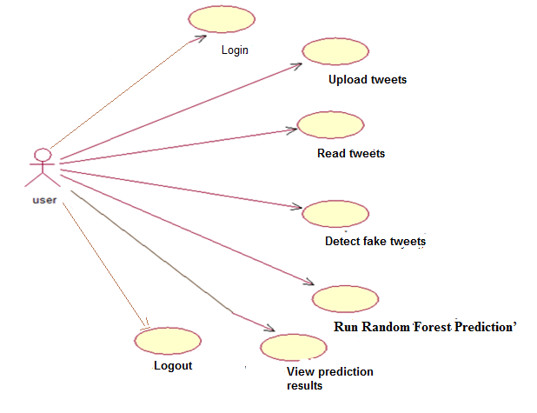
System Architecture:

Slide 11
Algorithms:
Naïve Bayes Classifier Algorithm
Naïve Bayes algorithm is a supervised learning algorithm, which is based on Bayes theorem and used for solving classification problems.
It is mainly used in text classification that includes a high-dimensional training dataset.
Naïve Bayes Classifier is one of the simple and most effective Classification algorithms which helps in building the fast machine learning models that can make quick predictions.
It is a probabilistic classifier, which means it predicts on the basis of the probability of an object.
Some popular examples of Naïve Bayes Algorithm are spam filtration, Sentimental analysis, and classifying articles.
Naïve Bayes algorithm is used to detect the user tweets whether the user tweets information is spam or non-spam. Naïve Bayes is better for classifying the user tweets with stemming techniques and stop words. And collect dataset from tweeter and it is used for classifying the user tweets into spammer or non-spammer.

Slide 12
Random Forest Algorithm
Random forest is a classifier that evolves from decision trees. It actually consists of many decision trees. To classify a new instance, each decision tree provides a classification for input data; random forest collects the classifications and chooses the most voted prediction as the result. The input of each tree is sampled data from the original dataset. In addition, a subset of features is randomly selected from the optional features to grow the tree at each node. Each tree is grown without pruning. Essentially, random forest enables a large number of weak or weakly-correlated classifiers to form a strong classifier.
Random Forest Prediction is used to train random forest classifier with extracted tweets features and this random forest classifier model will be used to predict/detect fake or spam account for upcoming future tweets.

Slide 13
Modules:
Designing Main Screen:
we are importing required packages like tkinter for the purpose of Graphical user interface, matplotlib for plotting graphs , skLearn for importing Machine Learning algorithms , pandas package for data analysis , numpy package for numeric operations.(analysis)
By using tKinter package we designed main Screen.
Naïve Bayes Classifier:
Here,we upload tweeter profiles which is the dataset.Then we pick naïve Bayes classifier and load it by removing all the stop words and keeping the text in lower case.(data preprocessing)
Then,we extract features from tweets like Retweets,followers,following,hashtags etc…Then we read the features from the dataset file.The dataset is in Json format.Then we insert all the features of the dataset.By using this algorithm we then predict whether the tweet contains spam words or not.
If the spam==0,then tweet contains no spam words else tweet contains spam words.
Likewise,if followers<following,then the account is considered to be fake and vice versa.

Slide 14
Random Forest algorithm:
we are using this algorithm to calculate accuracy by using training dataset.After finding the accuracy,we then classify the total
No.of accounts,no.of fake accounts,and no.of spam tweets by using Random Forest Classifier.

Slide 15
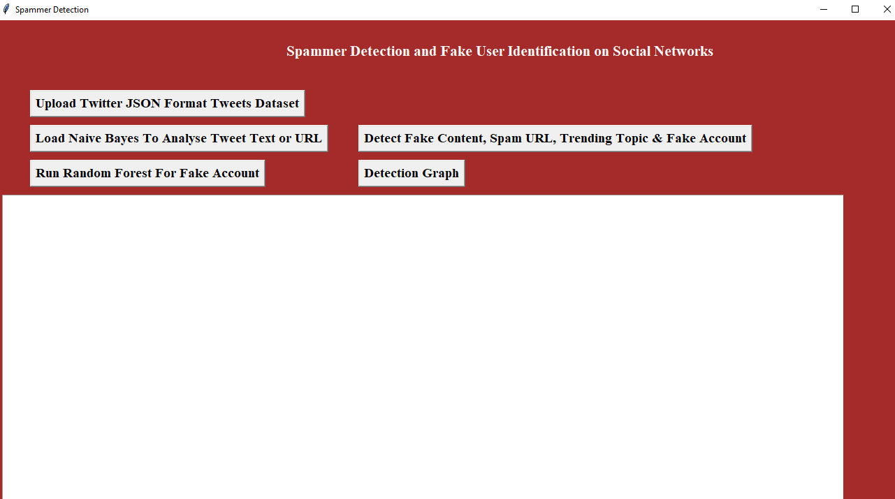
Experimental Results:
In above screen click on ‘Upload Twitter JSON Format Tweets Dataset’ button and upload tweets folder

Slide 16
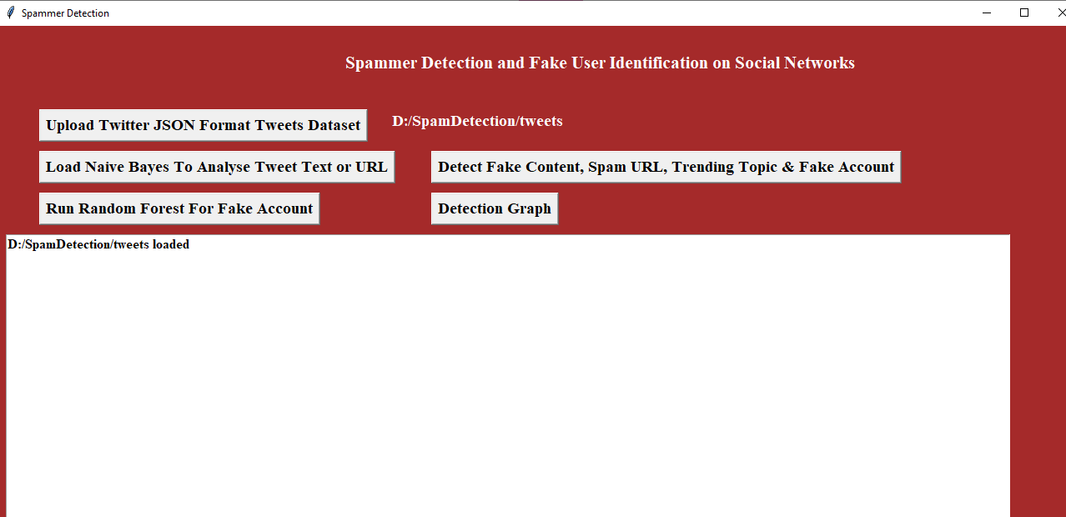
In above screen we can see all tweets from all users loaded.

Slide 17
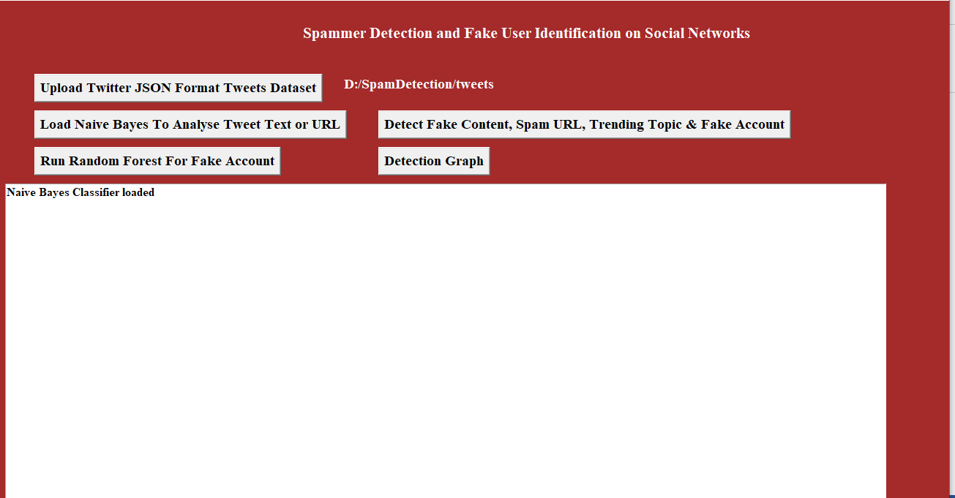
In above screen naïve bayes classifier loaded

Slide 18
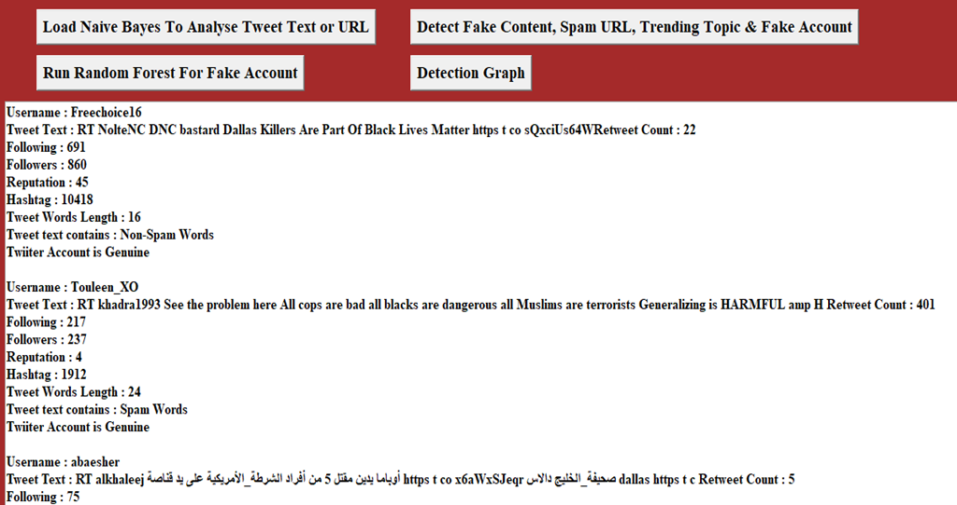
In above screen all features extracted from tweets dataset and then analyse those features to identify tweets is no spam or spam. In above text area each records values are separated with empty line and each tweet record display values as TWEET TEXT, FOLLOWERS, FOLLOWING etc with account is fake or genuine and tweet text contains spam or non-spam words.

Slide 19
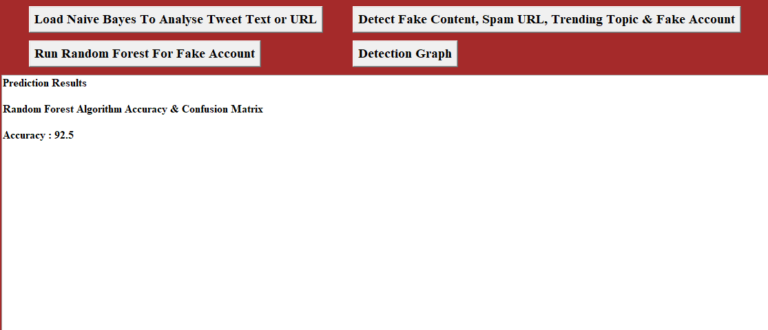
In above screen we got random forest prediction accuracy as 92.5%.

Slide 20
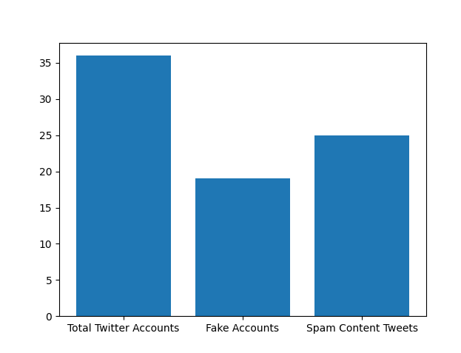
In above graph x-axis represents total tweets, fake account and spam words content tweets and y-axis represents count of them

Slide 21
Conclusion:
In this, we performed a review of techniques used for detecting spammers on Twitter. In addition, we also presented a taxonomy of Twitter spam detection approaches and categorized them as fake content detection, URL based spam detection, spam detection in trending topics, and fake user detection techniques. We also compared the presented techniques based on several features, such as user features, content features, graph features, structure features, and time features. Moreover, the techniques were also compared in terms of their specified goals and datasets used. It is anticipated that the presented review will help in finding the information on state-of-the-art Twitter spam detection techniques in a consolidated form.

Slide 22
References:
[1] B. ErÃ§ahin, Ã–. AktaÂ³, D. KilinÃ§, and C. Akyol, “Twitter fake account detection,'' in Proc. Int. Conf. Comput. Sci. Eng. (UBMK), Oct. 2017, pp. 388_392.
[2] “Detecting spammers on Twitter,'' in Proc. Collaboration, Electron. Messaging, Anti- Abuse Spam Conf. (CEAS), vol. 6,
[3] F. Benevenuto, G. Magno, T. Rodrigues, and V. Almeida,
[4] S. Gharge, and M. Chavan, “An integrated approach for malicious tweets detection using NLP,'' in Proc. Int. Conf. Inventive Commun. Comput. Technol. (ICICCT), Mar. 2017, pp. 435_438.
[5] T. Wu, S. Wen, Y. Xiang, and W. Zhou, “Twitter spam detection: Survey of new approaches and comparative study,'' Comput. Secur., vol. 76, pp. 265_284, Jul. 2018.

Slide 23
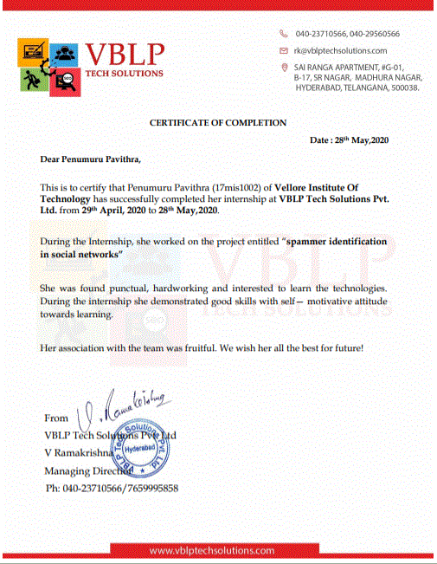
Certificate of Completion:

Slide 24
THANK YOU!

